Slide 1
Microsoft Azure Containers and Orchestration
Shimail Gillani
Cloud Solution Architect
Microsoft Education
Notes:
(Introductions and set expectations that this presentation is designed to discuss the role of Azure as the cloud computing platform for a business’s digital transformation.)

Slide 2


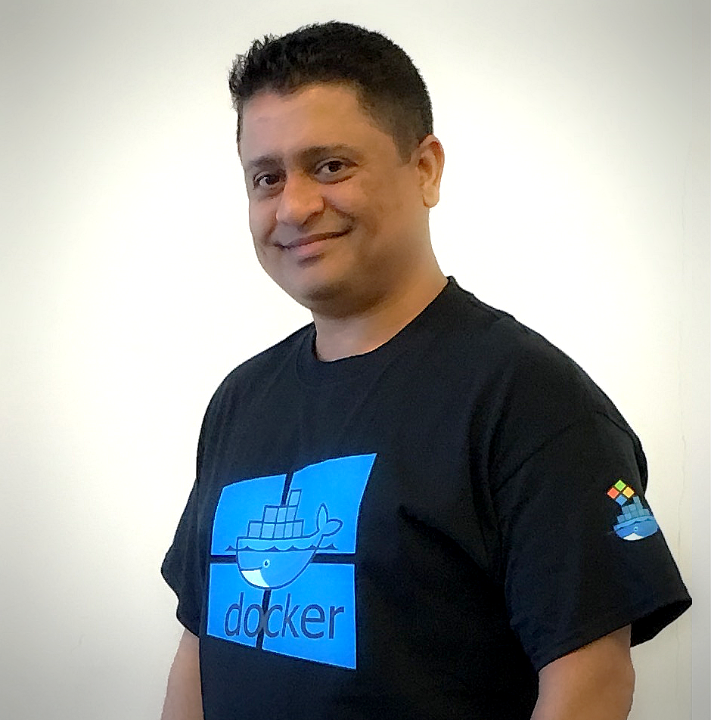

Shimail Gillani – Cloud Solution Architect ( aka @ChefGillani )
Recently Moved to Dallas, from New Jersey
Hybrid DevOps – 20+ Years (3 at Microsoft and Previously Ernst & Young)
MS Customer Success Unit - Solutions Architects team
Currently Helping:
Duke, U-Miami, U-South Florida, U-Texas,
Dallas and Minnesota – Colleges and University System
Previously Helped: Yale, Princeton, Johns Hopkins and U-North Carolina
Shimail.Gillani@Microsoft.Com Twitter: @ChefGillani GitHub: ChefGillani
Team Blog: https://blogs.msdn.microsoft.com/AzureEdu
Notes:
Technology is omnipresent. It’s shaping how businesses plan for innovation and growth within their markets. The importance of digital transformation is urgent; Since 2000, 52% of Fortune 500 companies are gone due to digital disruption.
We see companies responding by creating digital strategies across four core areas: engaging their customers, empowering their employees, optimizing their operations, and transforming their products.
Everyone is aware of how important this is. Look at a company like Uber for example. They’ve created a digital model for the taxi industry that has allowed them to surpass every other taxi company by double or more, recently valued at $62.5 Billion. They’ve created a significant shift in an industry that has been largely untouched for decades.

Slide 3
Containers
Next generation of virtualization
Isolated environment to run your applications
Lightweight alternative to virtual machines
Smaller, less costly, faster to start, and self-contained
Virtual Machines
App
App
App
Libraries
Libraries
Libraries
Containers
Guest OS
Guest OS
Guest OS
App
App
App
Libraries
Libraries
Libraries
Hypervisor
Container Engine
Host Operating System
Operating System
Notes:
A virtual machine is -- well -- a virtualized machine created and managed by a hypervisor such as VirtualBox or Hyper-V. Even though a VM runs on a machine that has an operating system, each VM requires its own complete operating system, even if it's the same operating system as the host OS. VMs offer a very high degree of isolation, but at a cost: longer startup times, lower portability (ever tried to move a 127 GB virtual hard disk, or VHD, from one PC to another?), and higher memory requirements. Containers, by contrast, leverage the operating system that is already in place but offer nearly as much separation. RAM requirements are lower since the OS isn't being duplicated in each container, and cost is lower, too, because while cloud platforms typically charge for each VM, a single VM can host multiple container instances.

Slide 4
Why Containers?
Enable ‘write-once, run-anywhere’ apps
Enables microservice architectures
Great for dev/test of apps and services
Production realism
Growing Developer Community
DevOps
Developers
Portability, Portability, Portability
Standardized development, QA, and prod environments
Abstract differences in OS distributions and underlying infrastructure
Higher compute density
Easily scale-up and scale-down in response to changing business needs
Operations

Slide 5
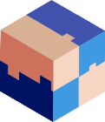


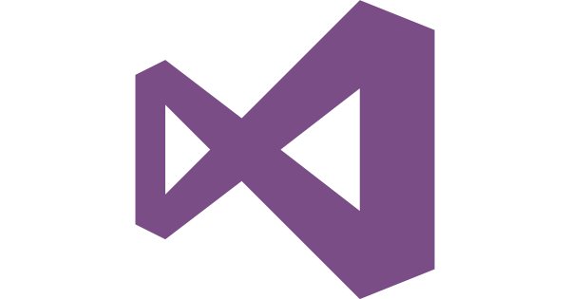
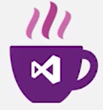
Microsoft & Containers– better together
Any OS
Arsenal
Linux Containers, Windows Server Containers, and Hyper-V Containers
Run on-premises, on Azure, on other public clouds, service provider clouds
Monoliths, Microservices, and other app types
Development frameworks and environments supported: Microsoft and ecosystem
Linux
Windows
Anywhere
On-premises
Hosted
Any app
Monolith
Microservice
Any language
.NET
Java

Slide 6


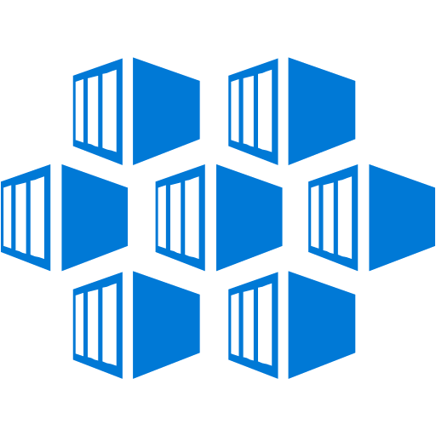
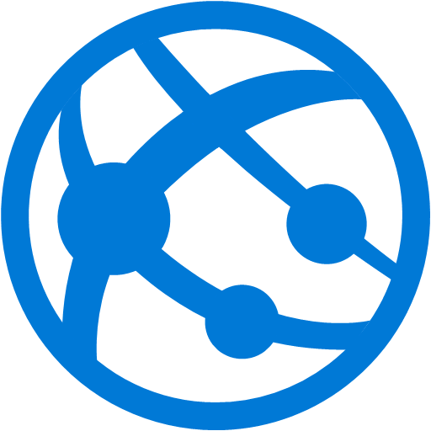

Microsoft Azure Support for containers
Managed Kubernetes
Virtual Machine / VM Scale Set / Azure Batch
(Deploy your own docker and orchestrator of choice)
Azure Container Service
(Docker Swarm, DC/OS, Kubernetes)
Azure Container Service – AKS
(Preview)
Web App for Containers
PaaS
PaaS
PaaS
IaaS

Slide 7

Docker
Leading open-source containerization platform
Supported natively in Azure
Docker containers wrap up a piece of software in a complete filesystem that contains everything it needs to run: code, runtime, system tools, system libraries – anything you can install on a server. This guarantees that it will always run the same, regardless of the environment it is running in
Notes:
Docker (www.docker.com) isn't the world's only containerization platform, but it is the most popular. It is free, open-source, and Linux-based, with Windows support (Windows Server 2016) in the works. It has earned massive mindshare in the developer community. And with Azure Container Service, you can deploy Docker containers to Azure with minimal effort. Moreover, Docker containers are easily moved between Azure and Amazon Web Services (AWS), affording developers portability between cloud platforms.

Slide 8


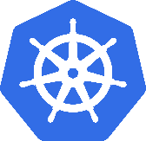

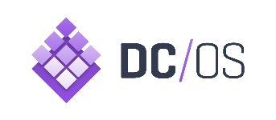
Azure Container Service
Application
Orchestrator
ARM
Resource Provider
Infrastructure

Slide 9

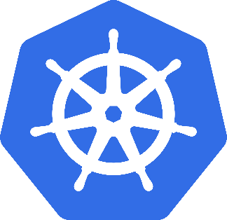

ACS: The best place to run your containers
Azure Container Service
Standard tooling and API support
Streamlined provisioning of DC/OS Docker Swarm and Kubernetes
Kubernetes
DC/OS
Swarm

Slide 10
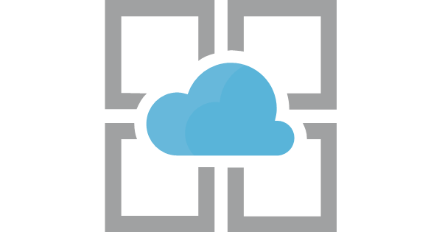
Exercise 3 - Containers and Azure App Service
3.1 Creating a web app from a built-in container
3.2 Creating a web app from a public Docker Hub container image
3.1 Creating a web app from a private Azure Registry container image
Azure App
Service

Slide 11
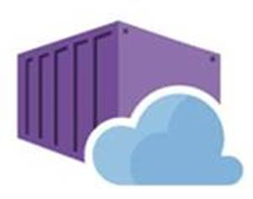
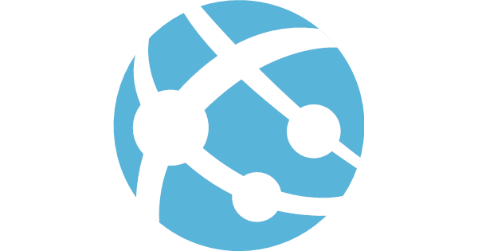

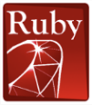


Web App comes to Linux (container support)
Bring your code
Bring your container
.NET Core
Web App for Containers
Deploy to Azure in seconds
Scale easily on demand
Designed for your agile web development needs

Slide 12




Deployment Life Cycle
Github repos
VSTS
Azure Container Registry
Local Git repos
Developers
Redis cache
Web App for Containers
Azure database for MySQL
CDN

Slide 13
Managed Kubernetes (Preview)
Azure Container Service

Slide 14
Managed Kubernetes: Overview
Fully managed Kubernetes control plane
Quick provisioning (<2min)
SLA-available service (99.95%)
Transparently scales with cluster size:
1, 50, 100, 250, 500, etc.
Upstream Kubernetes
Extensions from ecosystem

Slide 15
Thanks for Joining
Shimail Gillani
Cloud Solution Architect
Microsoft Education
Notes:
(Introductions and set expectations that this presentation is designed to discuss the role of Azure as the cloud computing platform for a business’s digital transformation.)

